Slide 1



Adaptive Calibration of Cat Qubits
Team: The_μediterranean_operators

Slide 2

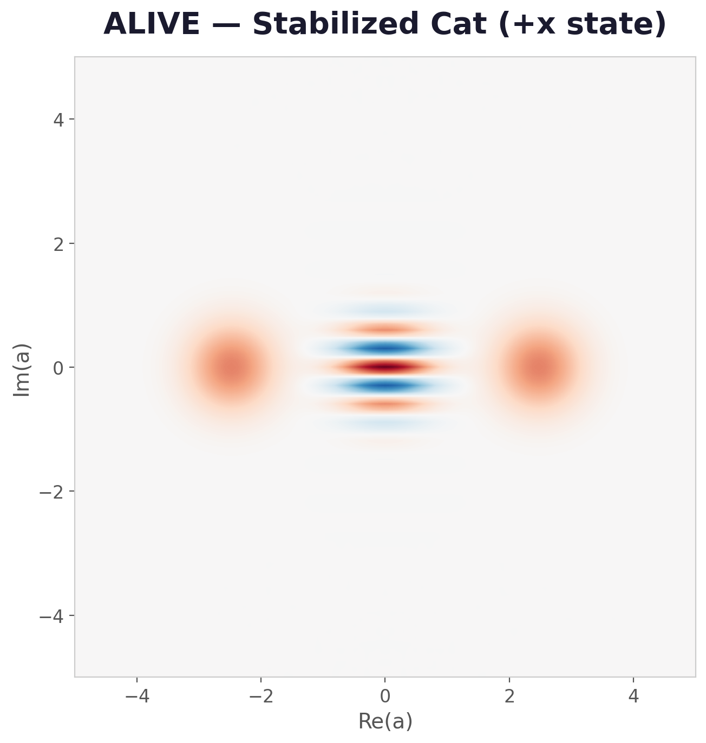
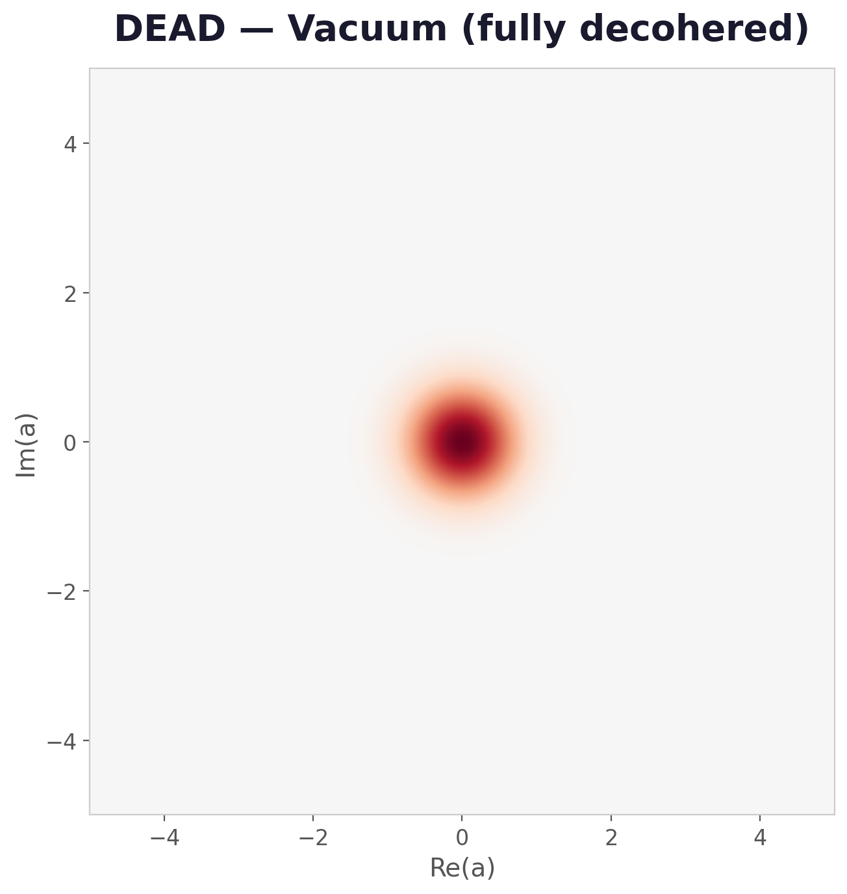
The Challenge: Keeping Cat Qubits Alive

Slide 3
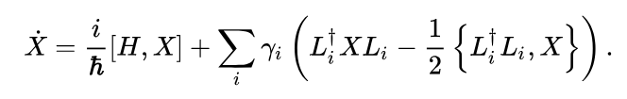
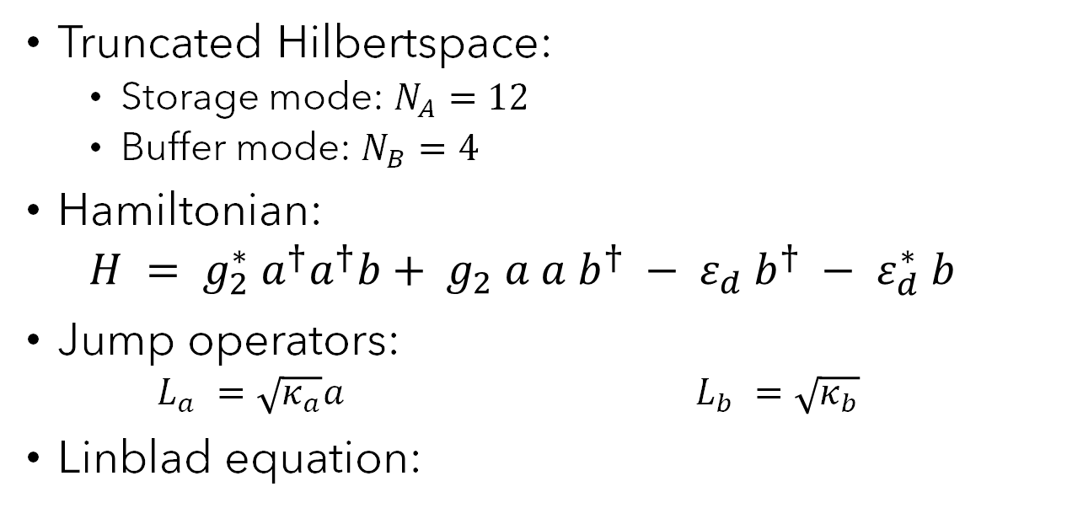
Model
Truncated Hilbertspace:
Storage mode: $N_{A}=12$
Buffer mode: $N_{B}=4$
Hamiltonian:
$$H = g_{2}^{∗} a^{†}a^{†}b+ g_{2} a a b^{†} − ε_{d} b^{†} − ε_{d}^{∗} b$$
Jump operators:
$$L_{a} =\sqrt{κ_{a}}a L_{b} =\sqrt{κ_{b}}$$
Linblad equation:

Slide 4
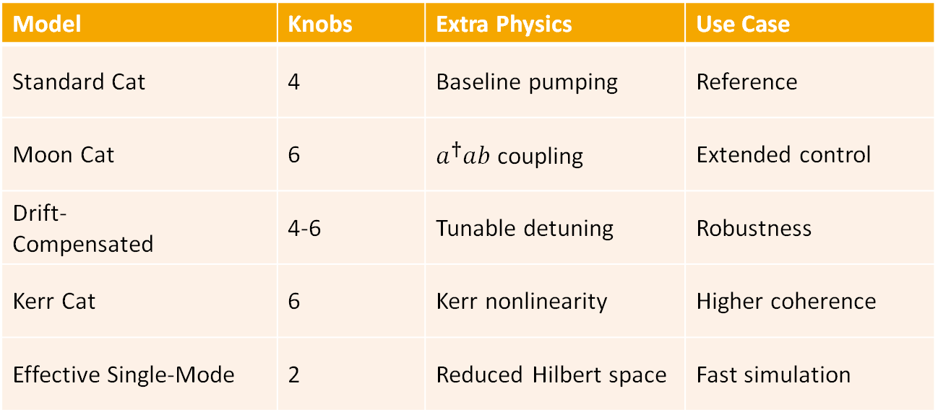
Model Variants
Model | Knobs | Extra Physics | Use Case
Standard Cat | 4 | Baseline pumping | Reference
Moon Cat | 6 | $a^{†}ab$ coupling | Extended control
Drift‑ Compensated | 4-6 | Tunable detuning | Robustness
Kerr Cat | 6 | Kerr nonlinearity | Higher coherence
Effective Single‑Mode | 2 | Reduced Hilbert space | Fast simulation

Slide 5





Problem Statement
Maximize lifetime of cat qubits under noise and drift.
$T_{x}$(Bit-flip lifetime)
$$η = T_{z} / T_{x}$$
$T_{z}$(Phase-flip lifetime)
With balancing control parameters under realistic quantum constraints.

Slide 6
Our Approach
1. Initialize a CMA-ES search distribution around the model's default knob values.
2. Ask for a batch of candidate knob settings from the current distribution.
3. Evaluate each candidate by building the Hamiltonian, simulating the dynamics, and measuring $T_{z}$, $T_{x}$, and bias.
3. Evaluate each candidate by building the Hamiltonian, simulating the dynamics, and measuring 𝑇_𝑧, 𝑇_𝑥, and bias.
4. Score each candidate with one of the reward functions defined before.
5. Tell the optimizer the rewards so it updates its sampling distribution.
6. Repeat under the current drift condition, tracking reward, $T_{z}$, $T_{x}$, and $η$over epochs.
6. Repeat under the current drift condition, tracking reward, 𝑇_𝑧, 𝑇_𝑥, and 𝜂 over epochs.

Slide 7
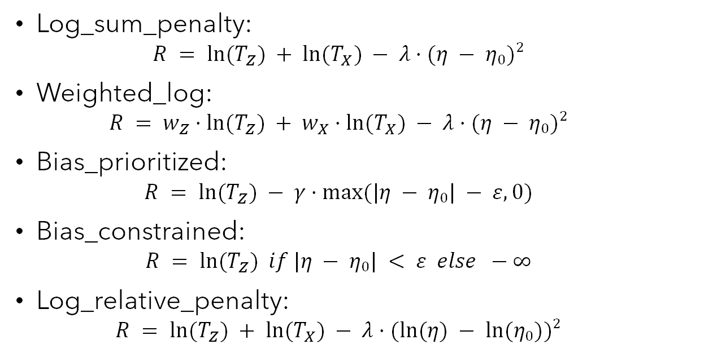
Reward function objectives
Log_sum_penalty:
$$R = ln⁡(T_{Z}) + ln⁡(T_{X}) − λ·(η − η₀)²$$
Weighted_log:
$$R = w_{Z}·ln⁡(T_{Z}) + w_{X}·ln⁡(T_{X}) − λ·(η − η₀)²$$
Bias_prioritized:
$$R = ln⁡(T_{Z}) − γ·max⁡(|η − η₀| − ε, 0)$$
Bias_constrained:
$$R = ln⁡(T_{Z}) if |η − η₀| < ε else −∞$$
Log_relative_penalty:
$$R = ln⁡(T_{Z}) + ln⁡(T_{X}) − λ·(ln⁡(η) − ln⁡(η₀))²$$

Slide 8
Computational Optimization
Running the optimizers with threads on the CPU.
Build a JAX optimized code for GPU.
Run our full list of 100 experiments on a cluster of CPUs.

Slide 9
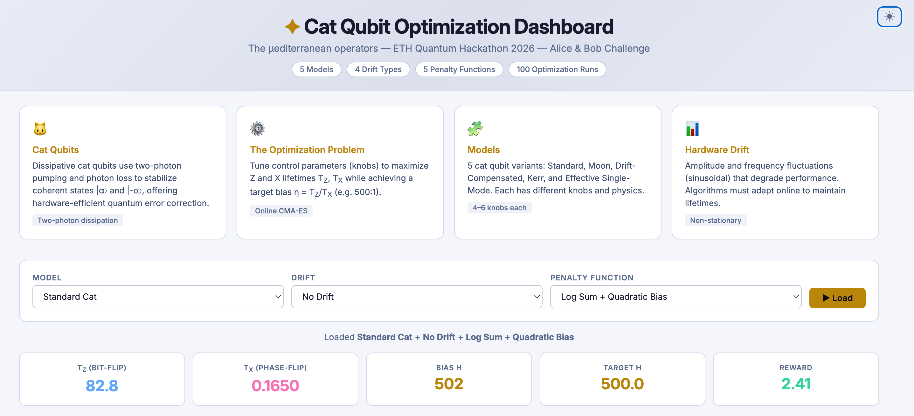
Results
+ Optimization Graphs

Slide 10
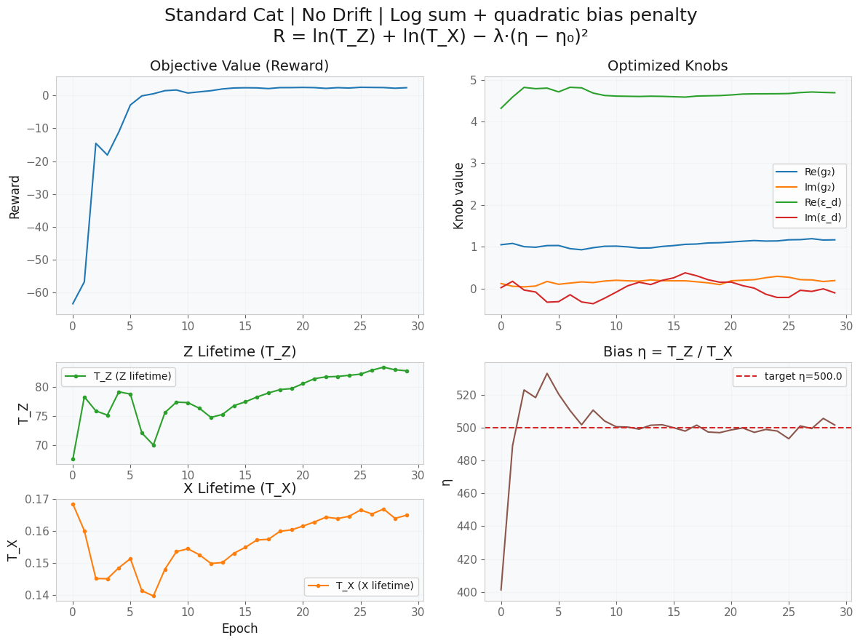
Results
Improved qubit lifetime
Stable convergence
Robust against drift
Competitive performance vs baselines

Slide 11
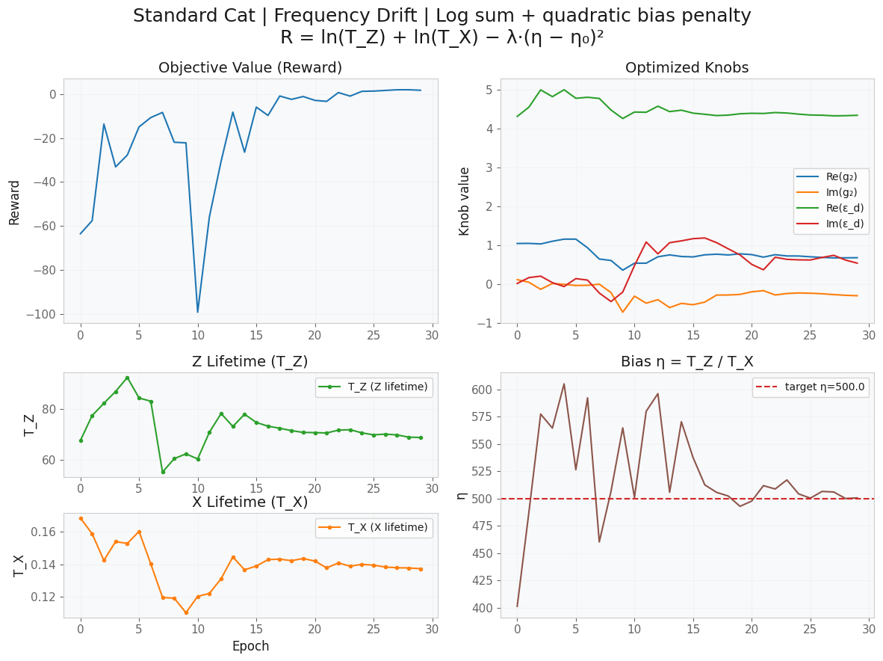

Slide 12
Initialisation

Slide 13
Amplitude Drift
Initial states: +x
+z

Slide 14
Frequency Drift
Initial states: +x
+z

Slide 15
Static Kerr Hamiltonian
Initial states: +x
+z

Slide 16
Moon Cat State Hamiltonian
Initial states: +x
+z

Slide 17

(Original) Cross-Kerr Hamiltoninan
Initial states: +x
+z

Slide 18
Results
Improved qubit lifetime
Stable convergence
Robust against drift
Competitive performance vs baselines

Slide 19
Future Work
Integrate more advanced or different optimizers
Improve drift modeling and real-time adaptation
Extend to multi-qubit systems

Slide 20
Conclusion
Successfully addressed challenge
Built reusable framework

Slide 21

Thank you
Any Questions?

